Slide 1

Polymer & it’s classifications
By
Mrs Juhi Rath
Department of Basic Sciences and Humanities
GIET University, Gunupur
Odisha, 765022 India

Slide 2
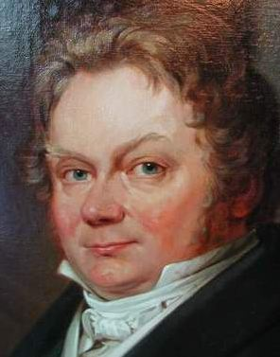
“the greatest joy of my life”
The term "polymer" was coined in 1833 by Jöns Jakob Berzelius

Slide 3
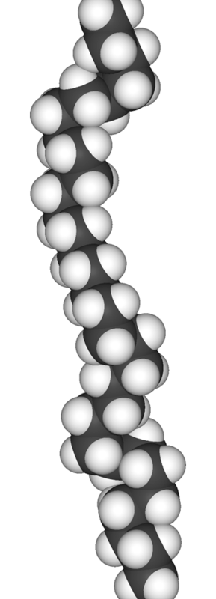
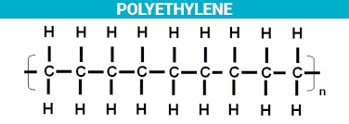
Polymer
When the number of monomer are joined together by covalent bond to form a long chain macromolecular structure and it is called as polymer.
n CH₂= CH₂ ^{Polymerisation} -CH –CH-_{n}
Ethene Polyethene
Monomer
The smallest repeating unit of polymer is known as monomer.
Polymerization
The process of formation of polymer from monomer is known as polymerization.

Slide 4
Classification of polymers
Classification based on the number of monomers
Classification based on source of availability
Classification based upon shape and structure.
Classification based upon molecular forces of attraction.
Classification based upon mode of tacticity or configuration.

Slide 5
A. Classification based on the number of monomers
It can be classified into two types
Homopolymer
Co-polymer
1.Homopolymer
In this polymer same monomer link together by covalent bond to form a
Long chain macromolecular structure. (Ex- Polyethene, Teflon, PVC)
Example- Polyethene is a polymer of monomer ethene. In this, the repeating structural unit is
n CH₂= CH₂ ^{Polymerisation} -CH –CH-_{n}
Ethene Polyethene

Slide 6
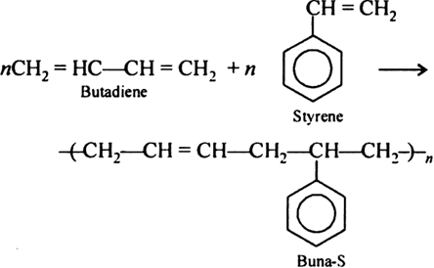
2.Co-polymer
In this polymer different monomers link together by covalent bond to form a long chain macro molecular structure. (Ex- nylon 6,6, Bakelite, Buna-S)

Slide 7
B.Classification based on source of availability
The polymer can be broadly classified as:
Natural polymers
Synthetic polymers
Semi-synthetic polymers

Slide 8
1.Natural polymers
The polymers obtained from nature (plants and animals ) are called natural polymers.
Examples:
Starch
Cellulose
Proteins
Nucleic acid
Natural rubber

Slide 9
2.Synthetic polymers
The polymers which are prepared in the laboratories are called synthetic Polymers. These are also called as man made polymers.
Polyethylene
PVC
Nylon
Teflon
Bakelite
Terylene

Slide 10
3.Semisynthetic polymers
These polymers are mostly derived from naturally occurring polymer by
chemical modifications.
Example:
Cellulose diacetate polymer
Vulcanized Rubber

Slide 11
C. Classification based upon shape and structure
On the basis of shape and strcuture of polymers , these can be
classified as:
Linear chain polymer
Branch chain polymer
Cross-linked polymer
1. Linear chain polymer
In this polymer the monomers link together by covalent bond to
form a longchain structure .
Ex- -C-C-C-C-C-C-C- , high density polyethelene (HDP), PVC, Nylon, Polyesters

Slide 12
2. Branch chain polymer
In this polymer the substituent are bonded to the skeleton of the long chain polymer.
Ex- low density poly ethylene (LDP) , glycogen and starch
3. Cross-linked or network polymers
The straight chain and branch chain polymer link together to formed a 3-D structure known as cross-linked polymer.
Ex- Bakelite, Melamine formaldehyde resin etc.

Slide 13
D. Classification based upon molecular forces of attraction
Depending upon the intermolecular forces, polymers have been classified
into four types.
Elastomers
Fibers
Thermoplastic
Thermosetting plastic

Slide 14
1. Elastomers
In this polymer the monomer are linked together by weak force of attraction
and can be straight ten times its original length.
eg:- rubber
2. Fiber
In this polymer monomers are linked by hydrogen bonding or electrostatic
force of attraction and posses strong intermolecular force of attraction.
Eg:- nylon 6,6

Slide 15
3.Thermoplastic
Long chain polymer in which the monomer link together with vanderwall force of attraction.
These are addition polymer.
It has low melting point , low molecular weight and low tensile strength.
It can be remodule number of times
Eg:- polyethene
4.Therosetting plastic
These are polymer in which the semi fluid of low molecular masses are heated to form 3-D cross-linked structure.
It can not be remoduled after getting hard solid from semi fluid.
These are the condensation polymer.
It has high melting point, high molecular weight , high density strength as compare thermoplastic.

Slide 16
E. Classification based upon mode of tacticity or configuration
Tacticity means orientation of side chain around the main backbone chain in
3-D structure of polymer.
Isotactic
Syndiotactic
Atactic
1. Isotactic:-
In this polymer all the functional group of the monomer are present the same side
of the plane.
-C-C-C-C-C-C-C-C-C-C-C-_{n}
F.G- Functional group
F.G
F.G.
F.G.

Slide 17
2. Syndiotactic:-
In case of syndiotactic functional groups are present are the alternative side of the plane.
--C-C-C-C-C-C-C-C-C-C-C-C--_{n}
3. Atactic:-
In this polymer the functional groups are randomly present on the plane of the
polymer chain.
--C-C-C-C-C-C-C-C-C-C-C-C--_{n}
F.G
F.G
F.G
F.G
F.G
F.G
F.G
F.G
F.G
F.G

Slide 18
Difference between Thermo plastics and Thermo setting polymers
Thermo plastics | Thermo setting
They soften on heating readily | They don't soften on heating. On prolong heating, however they burn.
They exhibit linear long chain structure | They have three dimensional network structure.
They are formed by addition polymerization. | They are formed by condensation polymerization.
They are usually soft, weak and less brittle. | They are usually hard, strong and more brittle.
Low molecular weight and low melting point | High molecular weight and high melting point.
Recycle and reuse | Can’t be recycle and reuse
EX- Polyethene, PVC, Poly styrene, PMMA | EX- Bakelite, Nylon-6

Slide 19
Difference between HDPE and LDPE
HDPE | LDPE
HDPE possesses low degree of branching. | LDPE possesses high degree of branching.
High tensile strength in HDPE the subtaining te mperature is 37 ºC. | low tensile strength.
Ionic polymerisation | Free radical polymerisation.
Density greater than 0.94 g/cm³ | Density greater than 0.91-0.94 g/cm³
Uses: It is used for prepare pipes, plastic buckets, toys, garbage container, wires, garments, Detergent bottles etc. | Uses: It is used for prepare carry bag or plastic bags, soft toys etc.

Slide 20
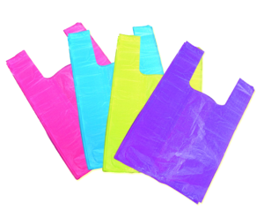
Types of Polymerization
Addition (chain Growth) Polymerisation:
Addition of monomers
No byproduct is formed
usually in presence of free radical initiator
Main features:
Only olefinic/vinyl compounds undergo this polymerization
Double bond provide required bonding sites
Rapid addition of monomer takes place
Elemental composition remains same for both reactants and product

Slide 21
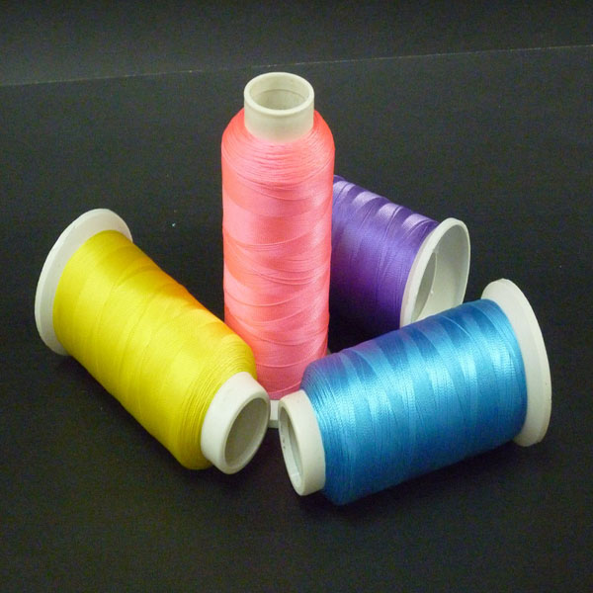
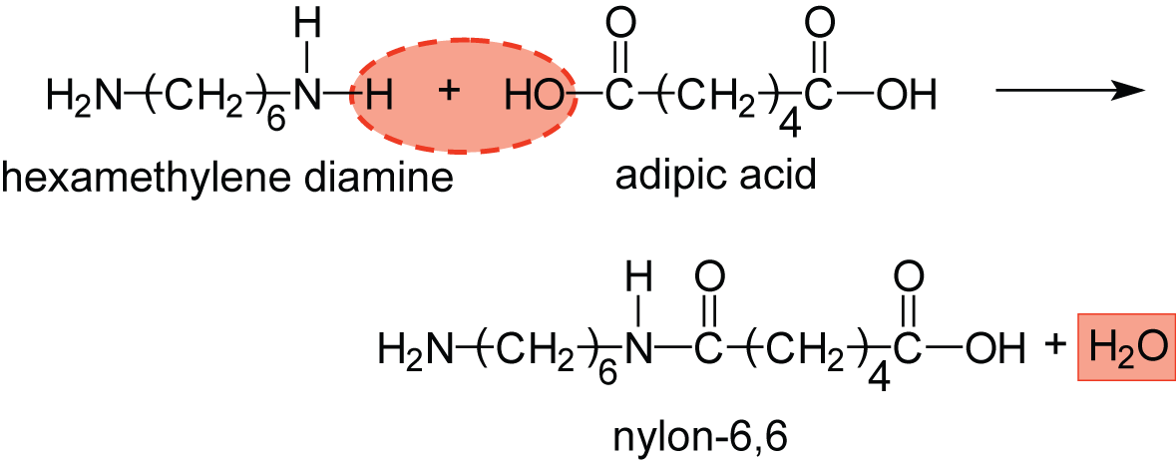
Condensation (Step Growth) Polymerisation:
Bi-functional/Polyfunctional monomer
Intermolecular condensation
Continuous elimination of byproduct
usually in presence of free radical initiator
Main features:
Polymerization is catalyzed by acids/alkalis
Polymerization is slow & stepwise
Elemental composition is different for both reactants and product
e.g. phenol-formaldehyde, epoxy resin, nylon 6,6

Slide 22
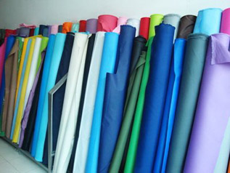
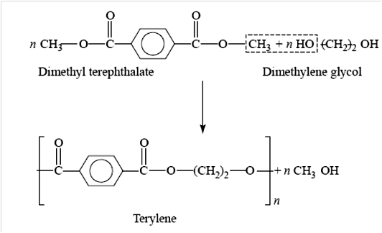
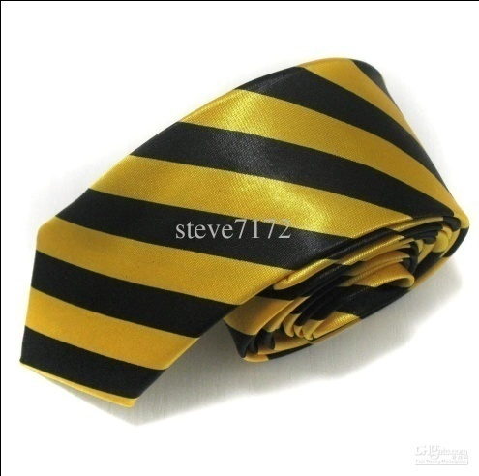
Terylene:
It is a synthetic polyester fibre produced by polymerizing dimethyl glycol and dimethyl terephthelic acid which is obtained from petroleum.
Uses: Terylene is mainly used in making plastic bottles and clothing. Terylene fiber is used as polyester tericot knit as a fashion garments fabric.

Slide 23
Polymers
Polyethylene
Poly acetylene
Poly aniline
Poly styrene
PVC
PMMA
PTFE
Bakelite
Nylon-6, Nylon-6,6

Slide 24
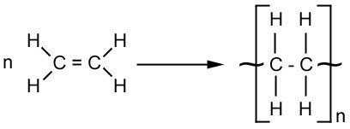
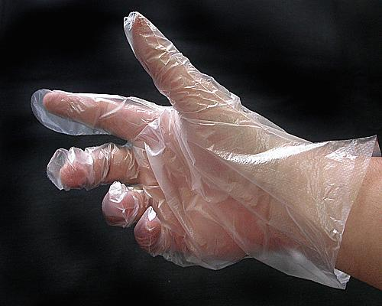
Synthetic polymers
Polythene
Polythene is made from the polymerization of ethylene (or ethene) monomer.
Ethene
Polythene
uses
Polythene used in applications ranging for films, tubes, plastic parts, laminates, etc. in several markets (packaging, automotive, electrical, etc.)

Slide 25
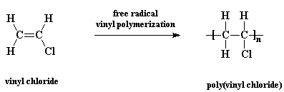
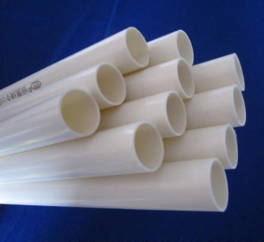
Polyvinyl chloride (PVC):
It is prepared by the polymerization of vinyl chloride. It is Prepared by addition polymerization.
n
Properties:
It is hard, brittle, rigid, flexible, high heat, resistance and good electrical insulator.
Uses:
PVC: manufacturing toys, packaging, coating, parts in motor vehicles, furniture, shoe soles, children's toys, handbags, luggage, seat coveringsetc, etc.

Slide 26
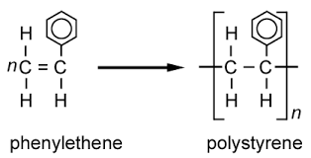
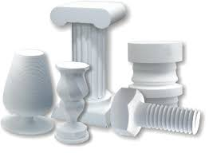
Polystyrene :
It is prepared by the polymerization of Phenyl ethene or styrene.
Properties:
It is transparent and posses moisture resistance.
High electric insulator.
Hard and brittle.
Uses:
It is used as electrical insulator, refrigerator parts etc.

Slide 27
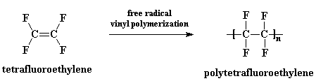
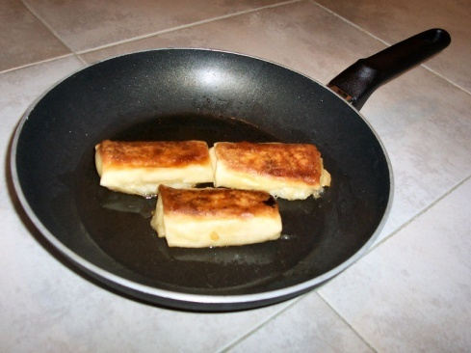
Polytetrafluoroethylene (PTFE):
It is prepared by addition polymerization of tetrafluoroethylene and also known as Teflon.
n
Properties:
It is strong nonflamable, synthetic resin, high resistance towards heat and water.
Uses:
It is used as electrical insulator, refrigerator parts etc.

Slide 28
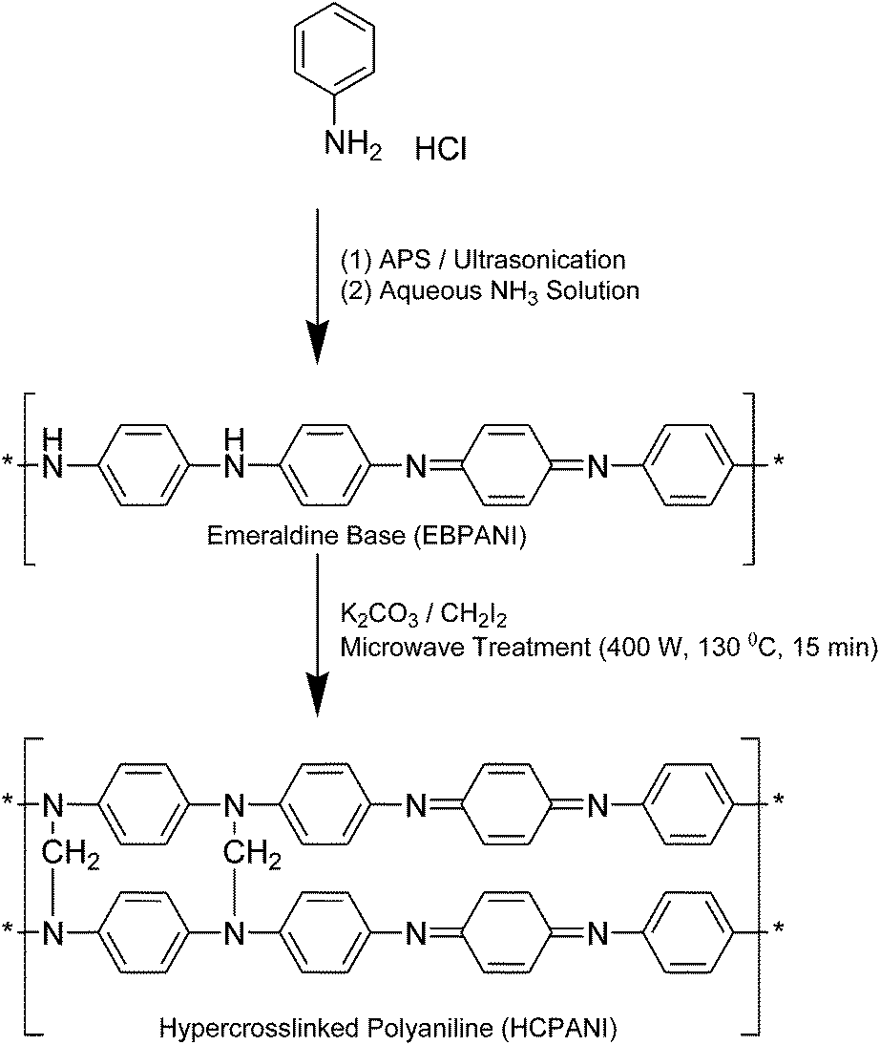
Polyaniline:
It is synthesized by chemical or elctrochemical oxidation of aniline in acidic medium using common oxidant such as ammonium peroxidisulphate..
(Aniline)
n
(Polyaniline)
Uses:
It is used in light weight battery and non linear optical material.

Slide 29
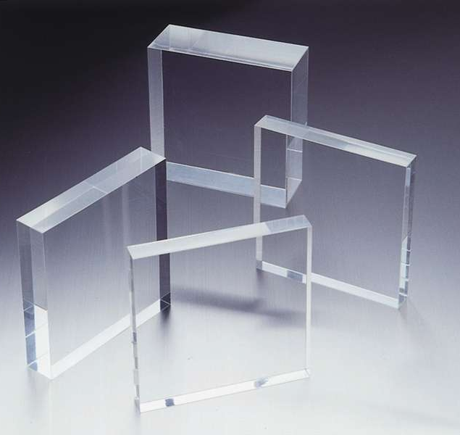
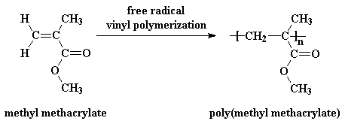
Polymethyl methacrylate (PMMA):
It is formed by the polymerization of methyl methacrylate.
n
Properties:
It is transparent, hard, light weight, high resistance power etc.
Uses:
It is used as hard lens, optical media and 3-D optical data storage, artificial teeth, TV screen, windows of car, etc.

Slide 30
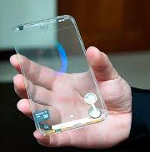
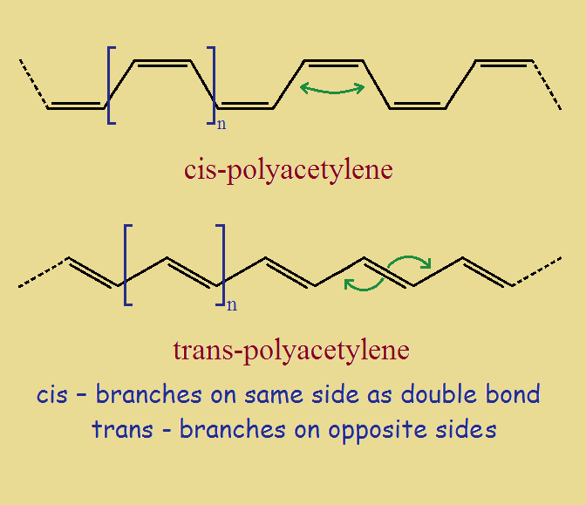
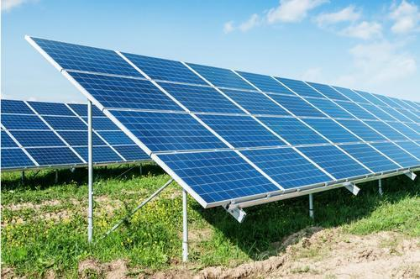
Polyacetylene : (First conducting polymer)
Polyacetylene is prepared by metathens polymerization of AsF₅ (Arsenic penta fluoride) is doped in Cis-poly acetylene at about 200 ⁰C to form trans-polyacetylene which has high electrical conductivity.
AsF₅
200 ⁰C
Uses:
It is used in solar cell, sensor, and electro chromic display etc.

Slide 31
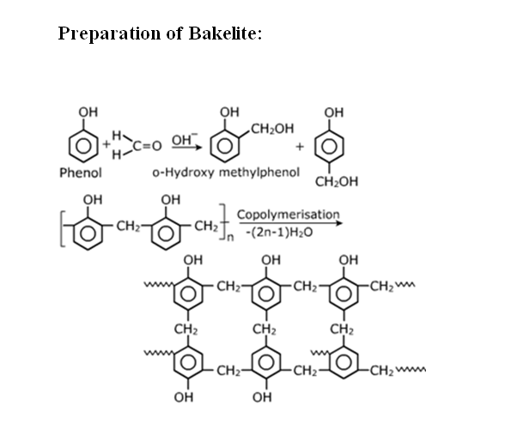
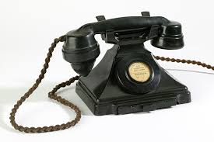
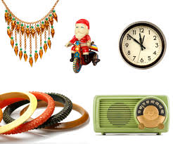
Bakelite:
It is formed by the condensation polymerization of phenol and formaldehyde , it gives orthohydroxy alcohol and parahydroxy alcohol. After polymerization of ortho and para compound to give a cross linked 3-D structure is known as Bakelite.
P-hydroxy methylphenol
n
Properties:
It has high thermal stability, hard and infusible and good electrical insulator.
Uses:
It is used to prepare switch and plucks.
It is used to make telephone parts, television cabinets.
It is used as ion exchange resin in softening of water.
n

Slide 32
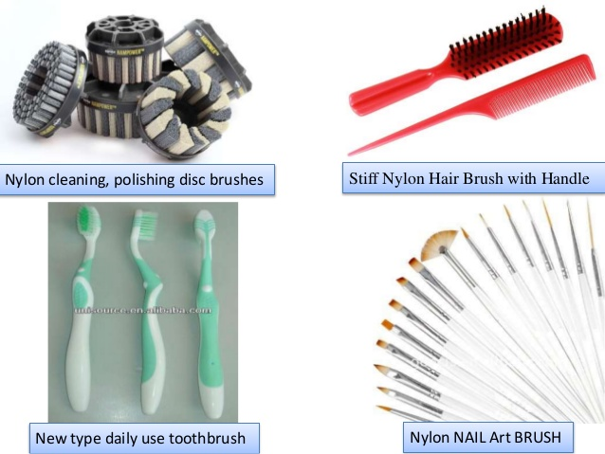
Nylon 6:
It is prepared by the self condensation of amino hexanoic acid.
Common name- ammino caproic acid
n
NH₂-(CH₂)₅- COOH + H-NH-(CH₂)₅- COOH
--NH-(CH₂)₅-CO-NH-(CH₂)₅-CO--
n
Properties:
These are brittle, flexible, electrical insulator.
Uses:
It is used to prepare brushes and tooth brushes.

Slide 33
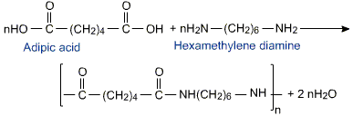
Nylon 6,6:
It is prepared by the condensation polymerization of adipic acid and hexamethylenidiamine with eliminating of H₂O molecule.
Nylon-6,6
Properties:
It is bad conductor of electricity, hard, flexible.
Uses:
It is used as fibers for clothing.
It is used as electrical insulator.

Slide 34
Biodegradable polymers:
Biodegradable polymer means the polymer which can degrade by microorganism.
EX- All natural polymer, polyglycolic acid etc.
Non-biodegradable polymers:
The polymer which resist to environment and cant be degrade by microorganism is called nonbiodegradable polymer.
EX- Thermoplastics, fibre, polythene etc.
Fibre reinforced polymer:
It is a composite material made up of polymer matrix with high strength fibres such as glass, aramid (adsorbs heat resistance) and carbon.
EX- it is used in aerospace, automatic machine, marine and construction industry.
Conducting polymer:
These are class of polymer which conduct electricity is called conducting polymer.

Slide 35
Thank You

